Slide 1
ESFs
1 – Transportation (BC Transportation)
2 – Communications (BSO)
3 – Public Works & Engineering (BC Public Works)
4 – Firefighting (BSO – Fire Rescue)
5 – Planning & Information (BC Emergency Management)
6 – Mass Care (BC Human Services)
7 – Resource Management (BC Finance & Admin Services)
8 – Health & Medical (Health Department)
9 – Search & Rescue (BSO – Fire Rescue)

Slide 2
ESFs
10 – Hazmat (BC EPGMD)
11 – Food and Water (BC Parks & Recreation)
12 – Public Utilities (BC Public Works)
13 – Military Support (BC Emergency Management)
14 – Public Information (BC Public Communications)
15 – Volunteers & Donated Goods (American Red Cross)
16 – Law Enforcement (BSO)
17 – Veterinary Concerns (BC EPGMD)
18 – Business & Industry (BC OESBD)

Slide 3
Overview: The 2013 Season
Hurricane season is June 1 – November 30
13-20 named storms predicted – winds of 39 mph or higher
7-11 could become hurricanes – 74 mph or higher winds
3-6 major hurricanes – 111 mph or higher winds
An active or extremely active season…

Slide 4
Overview: ESF 14 – Public Information
Role of the Emergency Hotline
Serving the public as the official source of accurate, reliable, timely information during an emergency
Providing public safety information
Dispel rumors and correct misinformation
Source of community feedback (two-way flow)
Notes:
The hotline is part of ESF 14 – Public Information.
During normal operations, the Broward County Call Center in a one-stop source of information and assistance with county agency programs and services. Residents call one number – 311 or 954-831-4000 to get their questions answered.
During an emergency, such as a hurricane, the Call Center becomes a 24/7 hotline. “311” is heavily promoted as the place for residents to call for information before, during and after a storm. During Hurricane Wilma in 2005, the hotline received more than 220,000 calls!
(ROLES)
EXAMPLE OF THE TWO-WAY INFORMATION FLOW:
During Hurricane Wilma, the Call Center was receiving calls from residents attempting to return home following the “all clear.” But a couple of the bridges crossing over the Intracoastal, which were being manned by BSO deputies, were locked in the “up” position. The Call Center was able to notify BSO of the problem. They contacted the deputies and gave them the “all clear” to lower the bridges, and the evacuated residents were able to return to their homes.

Slide 5
What we are up Against
Hurricane apathy- lack of enthusiasm or energy. Or general lack of concern or belief
Recent Polling
50% did not have disaster plans or a survival kit
1 in 3 said they would not prepare their home until a storm is within 24 hours of landfall
Notes:
Review slide
One more stunning poll result was that 30% of residents still thought that:
Taping their windows was an effective method of preparation during a hurricane.
Opening a window during a storm helps alleviate pressure in home, thus reducing the chance of damage

Slide 6
Emergency Plan Food and Water
Store water in plastic containers such as soft drink bottles. Avoid using containers that will decompose or break, such as milk cartons or glass bottles.
A normally active person needs to drink at least two quarts of water each day. Hot environments and intense physical activity can double that amount. Children, nursing mothers, and ill people will need more.

Slide 7
Emergency Plan Food and Water
Store one gallon of water per person per day.
Keep at least a three-day supply of water per person(including food preparation and sanitation)
Notes:
Five days or more are recommended

Slide 8
Emergency Plan Food and Water
Store at least a three-day supply of non-perishable food. Select foods that require no refrigeration, preparation or cooking, and little or no water.
Disaster Supplies Kit:
Ready-to-eat canned meats, fruits, and vegetables
Canned juices
Staples (salt, sugar, pepper, spices, etc.)
High energy foods
Vitamins
Food for infants
Comfort/stress foods

Slide 9
Hurricane Kit
Clothing, including rain gear and sturdy shoes
First aid kit
Medicines/prescription drugs: A two-week supply
Flashlight and extra batteries
Battery-operated or hand-crank radio
Tool kit
Toiletries
Trash bags
Books / games

Slide 10
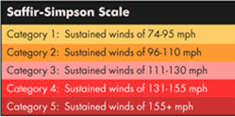
Hurricane Basics: Evacuations
Evacuations are ordered because of storm surge
-Category I-2: East of Intracoastal Waterway
-Category 3-5: East of U.S. 1/Federal Highway
-All mobile homes
Bridges are locked in the down position
Shelters open approximately four hours after the evacuation order is issued
Notes:
Evacuations are ordered because of storm surge-not winds.
When a hurricane is forecasted to be a Category 1 or 2, those who live east of the Intracoastal Waterway will be asked to evacuate. If a hurricane is forecasted to be a Category 3 or higher, all those residents living east of U.S. 1/Federal Highway, which includes all those along the coast will be asked to evacuate. In all cases, residents who live in a coastal or low lying area that floods frequently and those living in mobile homes will be asked to evacuate. We’re talking about roughly 144,000 residents evacuating in the case of a major hurricane plus those living in 25,000 mobile homes across the County.
When an evacuation is ordered, the bridges will be locked in the down position by the Coast Guard. This will assist those evacuating the coastal areas by car.
When an evacuation is ordered, it will take approximately four hours to open the first shelter and begin bus transportion along A-1-A and U.S. 1 for evacuees. The time is needed to allow staff to arrive and prepare the shelters and for the buses to stop their normal bus service and convert to evacuation services.

Slide 11
Hurricane Basics: Transit
When an evacuation is ordered, if buses are in service already, Broward County Transit (BCT) winds down service gradually. If the evacuation order is given before service begins, no buses are put out on the street. Evacuation service will coincide with the opening of American Red Cross shelters. It will not begin before shelters are open.

Slide 12
Hurricane Basics: Transit
In the case of a Category 1 or 2 hurricane (Evacuation Plan A), buses will pick up along A1A. In a Category 3 or higher (Evacuation Plan B), bus pick-up points will include A1A and Federal Highway.
Pick-up points are at any regular bus stop located along A1A on the beaches, and/or Federal Highway in a Category 3 or higher. Those evacuating from these areas can flag down any BCT bus for pick-up. All buses will be marked "Emergency Evacuation”
Notes:
When an evacuation is ordered, if buses are in service already, Broward County Transit (BCT) winds down service gradually. If the evacuation order is given before service begins, no buses are put out on the street. Evacuation service will coincide with the opening of American Red Cross shelters. It will not begin before shelters are open.

Slide 13
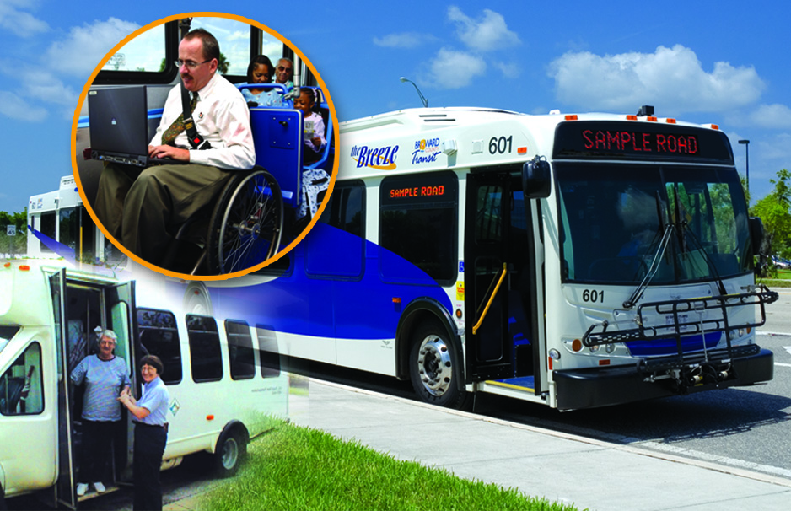
Hurricane Basics: Paratransit
Transportation services for residents with special needs
Separate transportation list for emergencies
Transportation to shelters and elsewhere
Hotline has a list of registered riders and can process a new request during an emergency
Run by Broward County Human Services
Notes:
The County offers free transportation to those who qualify and need paratransit transportation to a shelter.
The Hotline will receive a list of preregistered riders so you will be able to confirm transportation for a caller. If someone is not on the list and requests transportation, use the message form to record the caller’s name, address (including zip code), and phone and then give the message form to your lead worker for processing.

Slide 14
Hurricane Basics: Shelters
Three Types:
General Population Shelters
Special Needs Shelters
Pet-Friendly Shelter
Notes:
Outside the evacuation zones and mobile home communities, residents are encouraged to shelter at home, if they feel safe. It is where they will be most comfortable.
However, some residents may need to go to a shelter. There are three types of shelters in Broward County.

Slide 15
Hurricane Basics: Shelters
General Population Shelters
Run by the American Red Cross
Open to all; preregistration not available
Also appropriate for individuals with a self-managed health condition or disability
No animals allowed (except service animals)
No bedding available
Notes:
The first kind of shelter is the General Population Shelter. These shelters are run by the American Red Cross and are located in designated public schools throughout Broward County. They are open to everyone and preregistration is not available. For those who have a self-managed health condition or functional disability, the General Population Shelter is an appropriate option.
Pre-registration through Human Services is encouraged is a resident plans on going to General Population shelter and requires functional needs support services, such as assistance with eating, bathing and toileting, dressing and grooming, communicating, sleeping and taking medications.
Please note, shelters are not hotels and they offer just the basics in accommodations. They should be the shelter option of last resort.
Pets – except for service animals - are not allowed in shelters.

Slide 16
Hurricane Basics: Shelters
Special Needs Shelters
Run by Broward County Human Services
Greater level of care than General Population Shelter
Basic medical assistance and monitoring
Back-up electricity; essential medical equipment
Can provide functional needs services
Pre-registration strongly recommended
Notes:
The second type of shelter is Special Needs. These shelters are run by the Broward Health Department and are for those who have a medical condition that requires a greater level of care than that provided in a General Population Shelter, but does not require hospitalization. This shelter offers basic medical assistance and monitoring and is staffed by qualified medical personnel and has back-up electricity for limited lighting and essential medical equipment, for example a sepak machine, or an inhalator machine. Special Needs Shelters also provide functional needs support services.
Residents who require a Special Needs shelter are strongly encouraged to pre-register with the County. The Elderly and Veteran’s Services Division maintains the database of those who have registered throughout the year. As a storm approaches, you may get a call from a resident that has made a last minute decision to go to a special needs shelter. We will try to accommodate that individual, even though they have not preregistered.
In your packet the Hotline Message form has a box to check for the Special Needs sheltering. Complete all the required information on the form and give it to your Lead Worker. Human Services staff will call the individual back to further assess individual’s need(s).
If an individual’s medical needs exceed the level of care provided at a Special Needs Shelter, such as requiring hospitalization or one-on-one care, residents should work with their medical care provider to arrange the safest shelter option. It could include a stay in a hospital or other medical facility.

Slide 17
Hurricane Basics: Shelters
Pet-Friendly Shelter
Run by American Red Cross and the Humane Society of Broward County
for individuals with pets who live in evacuation zones
pre-registration required
owner must shelter with and take care of pet

Slide 18
Tools You Can Use
Vulnerable Population Registry
American Red Cross Safe and Well List
Home Damage Assessment Report
Broward.org/Hurricane
Social Media

Slide 19
Vulnerable Population Registry
For residents who are at risk due to disability, frailty or health issues, who elect to stay at home in the event of a hurricane or other emergency.
Joint partnership between all municipalities and Broward County to assist emergency responders in recovery efforts
Not a guarantee of services
www.broward.org/Registry or call 311

Slide 20
Red Cross Safe and Well List
Tool for those displaced by disaster, as well as those looking for someone who was
http://www.redcross.org/find-help/contact-family

Slide 21
Home Damage Assessment Program
Residents help assess home damage immediately after the storm
Allows County to quickly determine areas of greatest damage/emergency need
Resident feedback provided via Web, mobile app or 3-1-1.
Broward.org/hurricane
Notes:
This program actually was introduced last year, but it never has been used in an activation and there are some changes that are new. Home Damage Assessment Program is a program that enables residents to assess their home damage following a storm, so that the County can better assess where the damage is most prevalent, prior to an grid-by-grid damage assessment by emergency response personnel. Residents communicate with the County via the Web, mobile app or 3-1-1.

Slide 22
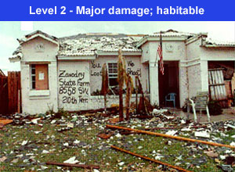
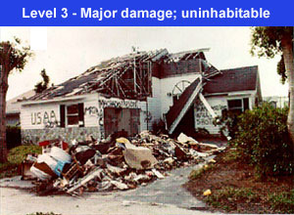
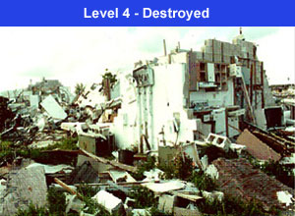
Home Damage Assessment Program
Notes:
*Let’s go to Broward.org/hurricane and see how this works. The photo shows four levels of home damage. The resident selects the photo that most resembles their damaged home and hits submit. We encourage residents to download the photos and keep as part of their hurricane kit PRIOR to the storm, so should we lose power, downloading photos will not be an issue for reporting damage. It’s important to note that the Home Damage Assessment program incorporates GIS mapping technology, so when the form is received from the resident, the County knows exactly where their home is located.
I encourage you all to download the Home Damage Assessment Program from your computer now as part of your hurricane kit and also try accessing it on your smartphones.

Slide 23
Broward.org/hurricane

Slide 24
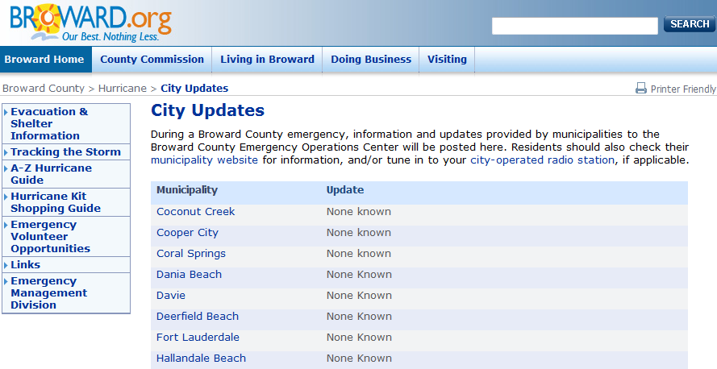
Broward.org/hurricane cont.
New Website Templates
Notes:
Boil Water Orders
Closing and Cancellations

Slide 25
Social Media
Quick and effective method for instant communications
Rapid reach to interested audience
Staying Connected:
-Twitter@ReadyBroward
- Facebook@BrowardEMD
-Hurricane Update E-Mail

Slide 26
Non-Traditional Communications Plan
High schools as gathering places
Code Red
Reverse 911
RACES
Fliers/fact sheets at distribution centers
Digital reader boards on highways
Airplane banners, blimp, large balloons,
Loud speakers/bullhorns
Door-to-door
Community meetings
Notes:
.

Slide 27
Call The Hotline
954-831-4000
Or dial 3-1-1 from any mobile phone

