Slide 1
Tactical mindfulness
Lt. Maureen M. Themis-Fernandez
Davie Police Department

Slide 3
Classic trunk monkey
CLICK HERE

Slide 4
Mindfulness in government

Slide 5
I never thought it would be me!

Slide 6
Origins of mindfulness

Slide 7
Origins of mindfulness
Jon Kabat-Zinn – 1979 – University of Massachusetts Medical School
UCLA
Jupiter Medical Center, Palm Beach County Florida
University of Miami

Slide 8
Mindfulness now
Schools
Legal Arena “Mindful Law”
Sports Arena: Seattle Seahawks, Miami Heat
Military for PTSD
Indian & British Parliaments
Fortune 500 Companies
Mindful Magazine

Slide 9
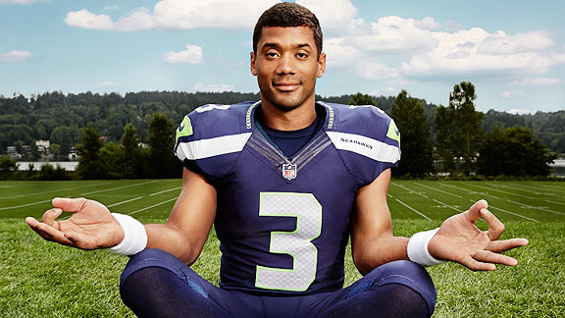

Slide 10
Mental & physical Health benefits of mindfulness
Antidote to the Inflammatory Response – results from stress hormones
Allows you to manage anxiety & effects of witnessing traumatic events
Lowers Blood Pressure
Positively develops areas of the brain responsible for memory/focus, self-esteem, and happiness
Better relationship with food, easier weight management
More relaxed muscles
Longer life- protects & elongates telomeres
Pain relief- as much as 40%

Slide 11
mental & physical benefits
Improved immune system
Improved ability to learn
Less cynicism in your personal life
Improved sleep
Less anger and inappropriate emotional reactivity (respond vs react)
Creative problem solving
Better Listening skills

Slide 12
Organizational & professional benefits
Increased resilience & ability to sustain performance
Better Judgment and decision making
Improved concentration on task at hand and an enhanced ability to stay focused, making one more effective
An ability to prioritize
Enhanced capacity to work on multiple projects
Improved time management
Improved ability to problem solve by seeing situations with greater clarity

Slide 13
Organizational & professional benefits
An ability to effectively coach or mentor staff
Better handling of stressful situations and working more effectively under pressure
Increased ability to listen to others and utilize feedback
An ability to anticipate & serve public needs
Creativity

Slide 14
Mindfulness & team training

Slide 15
MINDFULNESS & TEAM TRAINING
Improved team effectiveness, including more effective & efficient meetings of significantly shorter duration
Improvement in team performance and fewer miscommunications/ misunderstandings
The ability to determine what underlies most conflicts and to arrive at a mutually beneficial conclusion
Individuals & teams with greater innovation & inspiration
Greater collaboration and cooperation, & joint problem solving
Enhanced communication within & across teams
Enhanced ability to anticipate & serve public needs
Greater compassion & empathy

Slide 16
What is mindfulness?

Slide 17
Key facts about mindfulness
The practice of Mindfulness does not slow down your response to danger
Applying Mindfulness in one area of our lives can positively impact others
Differs from traditional meditation: Purpose is not necessarily to quiet your mind but to raise your level of awareness

Slide 18
Abcs of mindfulness
ABCs = Awareness + Breathe = Connection

Slide 19
Awareness components
Thoughts
Emotions
Physical Sensations
Behavior

Slide 20
aware
You are aware of your thoughts and feelings moment by moment
You are aware of how different people and situations affect you
R.A.I.N. Method: Recognize, Allow, Investigate, Needs
Brain Function Review – Limbic vs. Frontal Cortex
Lt Colonel Story – RAIN Application

Slide 21
Mindful tactics
Breathe Awareness
Naming the Objects in the Room, Car
Sights & Sounds
Body Scan
Standing Stretches
Mindful Eating
Mindful Walking
Writing & Coloring

Slide 22
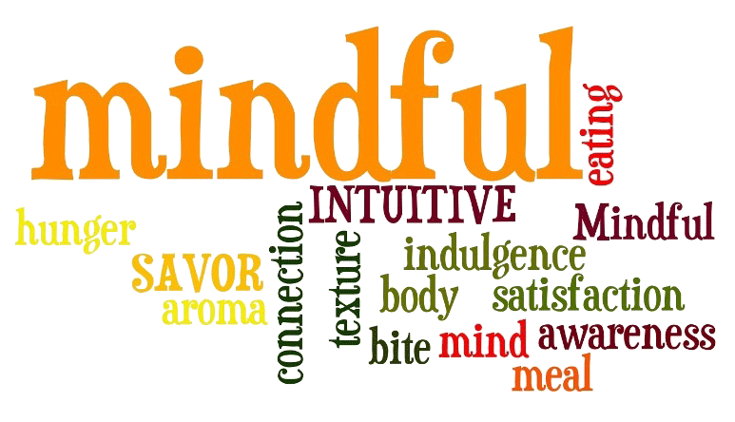
Mindful eating

Slide 23
GENERAL FACTS ABOUT MODERN EATING & mindfulness
We spend 39% of our lives on diets; barrage of conflicting information
Food can be used for other purposes besides nutrition; misused & abused to meet other needs
Mindfulness can help you take your eating off autopilot
Mindfulness can give you the “pause” to become aware of feelings, thoughts, and bodily sensations
Stress hormones cause us to store fat
Mindful Eating helps you maximize your nourishment from food & manage your weight effectively

Slide 24
Mindful eating tactics
PART 1: RAISE YOUR AWARENESS
PART 2: ENGAGE YOUR SENSES
PART 3: IN PROGRESS MINDFUL EATING

Slide 25
Part 1: Raise your pre-meal awareness
BODY POSTURE: STAND, RELAX, AND BREATHE I.E. MOUNTAIN POSE
MINDFUL BREATHING WHILE SEATED
BODY SCAN
NAME THE OBJECTS IN THE ROOM
SIGHTS & SOUNDS
STANDING STRETCHES
MINDFUL WALKING
AWARENESS & SENSES

Slide 26
PRE-MEAL AWARENESS CHECKLIST
What Am I Hungry For? Is it Food? How do I know?
If it is Food, proceed to Part 2
If it isn’t, ask yourself, What Do I Need?

Slide 27
What do I need (besides food)?
Support
Comfort
Movement
Silence
Fun
Reflection
Work
Play
Rest
Romance
Nature
Creativity/Purpose

Slide 28
Part 2: Engaging your senses
How many senses do you have?
ANSWER: 5
Sight, smell, hearing, touch, and taste

Slide 29
Part 3: “in progress” mindful eating
1. Am I sitting down?
2. Am I eating fast or slow?
3. Am I mindlessly munching or noticing each bite?
4. How Hungry Am I? on scale from 1 to 10
5. Am I multitasking or enjoying my meal?

Slide 30
Part 3: “in progress” –breathe, scan, and cover
COVER: Stop, re-engage or wrap it up
SCAN: Assess Food & Hunger
BREATHE: Chew thoroughly, savor food, slow down

Slide 31
How can mindfulness help you professionally?

Slide 32
PROFESSIONAL MINDFULNESS
Ability to calm yourself in the face of stress or difficult decisions – have a calming effect on those you lead
Understand how you perceive situations, what drives you, how you think and feel about what arises
Ability to be in the present moment, clearly understand what you are seeing, reading, and hearing
Ability to set in motion positive outcomes in your professional and personal life, clearly develop vision and strategies for yourself
Ability to know that all situations are temporary

Slide 33
Key qualities developed through mindfulness
EQUANIMITY: accepting things you can’t control in any given moment (also accepting related thoughts, feelings, emotions)
CONCENTRATION: distractions remain in background, see opportunities that may have been obscured, listen more strategically
CLARITY: understand what drives you & you remain “mindful” of goals & objectives, mission & vision
PURIFICATION: clearing away of negative, habitual patterns

Slide 34
8 ways MINDFULNESS transformS yourself & inspire others
Present
Aware
Calm
Focused
Clear
Equanimous
Positive
Impeccable

Slide 35
Where can I get more information on mindfulness?
Insight Timer – Free App
Palousemindfulness.com
Mindful Magazine
South Florida Center for Mindfulness

Slide 36
Formal training
Mindfulness Based Stress Reduction (MBSR)
Mindfulness Based Cognitive Therapy (MBCT)
Mindfulness Based Resilience Training (MBRT)

Slide 37
MINDFULNESS “MUSCLE”

Slide 38
we are in this together!

Slide 39
Lt. Maureen M. Themis-Fernandez
Davie police department
1230 South Nob Hill Road
Davie, Florida 33324
maureen_themis-fdez@davie-fl.gov (954)275-2204

