Slide 1



Vacation Rental Registration and Enforcement Program
^{CITY OF FORT LAUDERDALE}
Development Services Department
Community Enhancement & Compliance Division

Slide 2

Porshia’s Background
^{CITY OF FORT LAUDERDALE}
^{Department of}
^{Sustainable Development}
Community Enhancement & Compliance Division
Paralegal U.S. Army
Vacation Rental Program Administrator/Guru from 2015 thru 2019
Personal Vacation Rental Experiences

Slide 3
Katrina’s Background
^{CITY OF FORT LAUDERDALE}
^{Department of}
^{Sustainable Development}
Community Enhancement & Compliance Division
Certified Enforcement Professional
Former Vacation Rental Code Enforcement Officer
The “NEO” of Vacation Rentals in Fort Lauderdale

Slide 4
Presentation Overview
^{CITY OF FORT LAUDERDALE}
^{Department of}
^{Sustainable Development}
Community Enhancement & Compliance Division
Program Overview
Registration
Inspections Standards
Enforcement
Technology
Recommendations for Creating a Program

Slide 5
Program Timeline
^{CITY OF FORT LAUDERDALE}
^{Department of}
^{Sustainable Development}
Community Enhancement & Compliance Division
Date | Action
May 19, 2015 | Short Term Rental Enforcement Discussion at City Commission Conference
August 18, 2015 | Article X, Vacation Rentals Adopted
November 1, 2015 | Article X, Vacation Rentals Effective for Enforcement
June 29, 2016 | Public Outreach Meeting
July 14, 2016 | Public Outreach Meeting
August 4, 2016 | Public Outreach Meeting
September 22, 2016 | Public Outreach Meeting – Note: Meeting directed at September 7, 2016 City Commission Meeting
September 28, 2016 | Public Outreach Meeting
December 6, 2016 | Article X, Vacation Rentals (Amended) Adopted
January 31, 2017 | Article X, Vacation Rentals (Amended) Effective for Enforcement
May 6, 2019 | Contracted with New Vendor to Provide Monitoring Services

Slide 6
Florida Statutes Governing Vacation Rentals & Enforcement
Section 509.013, Florida Statutes
  Transient public lodging defined
Section 509.242, Florida Statutes
  Vacation rental defined
Chapter 162, Florida Statutes
  Enforcement of municipal codes

Slide 7
City of Fort Lauderdale Ordinances Governing Vacation Rentals
Chapter 15 of the Code of Ordinances of the City of Fort Lauderdale
Chapter 11 of the Code of Ordinances of the City of Fort Lauderdale

Slide 8
What is a Vacation Rental?
^{CITY OF FORT LAUDERDALE}
^{Department of}
^{Sustainable Development}
Community Enhancement & Compliance Division
Types of Properties
Duration of Stay
Unit or Group of Units in:
  Condominiums
  Cooperatives
Individually or Collectively Owned:
  Single-Family
  Two-Family
  Three-Family
  Four-Family
Four or more times in a calendar year for less than 30 days or one calendar month (whichever is less).

Slide 9
What is Not a Vacation Rental?
^{CITY OF FORT LAUDERDALE}
^{Department of}
^{Sustainable Development}
Community Enhancement & Compliance Division
Timeshares
Any property with 5+ Units
Accessory structures in specific zoning areas

Slide 10
Program Staff Resources
^{CITY OF FORT LAUDERDALE}
^{Department of}
^{Sustainable Development}
Community Enhancement & Compliance Division
  (1) Administrative Supervisor
  (2) Administrative Assistants
    Registration/Application Processing
    Notifications for Enforcement
  (3) Code Compliance Officers

Slide 11
Website Essentials www.fortlauderdale.gov/vacationrental
^{CITY OF FORT LAUDERDALE}
^{Department of}
^{Sustainable Development}
Community Enhancement & Compliance Division
Definition of Vacation Rentals
Steps for Registration
  Document Checklist
  Include Visuals for Inspections
  Registered Properties
  Unregistered Properties
  Instructions for Reporting

Slide 12

Registration Process www.fortlauderdale.gov/vacationrental
^{CITY OF FORT LAUDERDALE}
^{Department of}
^{Sustainable Development}
Community Enhancement & Compliance Division

Slide 13
State and County Licensing
^{CITY OF FORT LAUDERDALE}
^{Department of}
^{Sustainable Development}
Community Enhancement & Compliance Division
Florida Agency | Document Type
Department of Business and Professional Regulations (DBPR) | License for Transient Public Lodging Establishment
Department of Revenue (DOR) | Sales Tax Collection
Broward County | Business Tax Receipt
Broward County | Tourist Development Tax

Slide 14
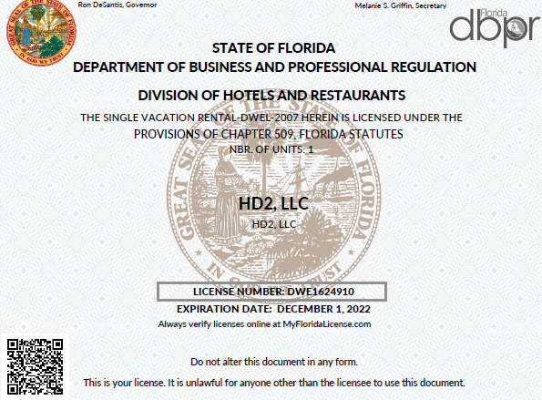
DBPR

Slide 15
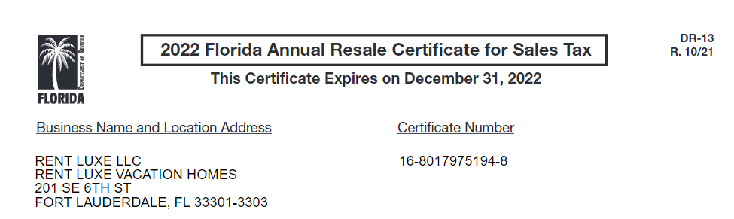
DOR

Slide 16
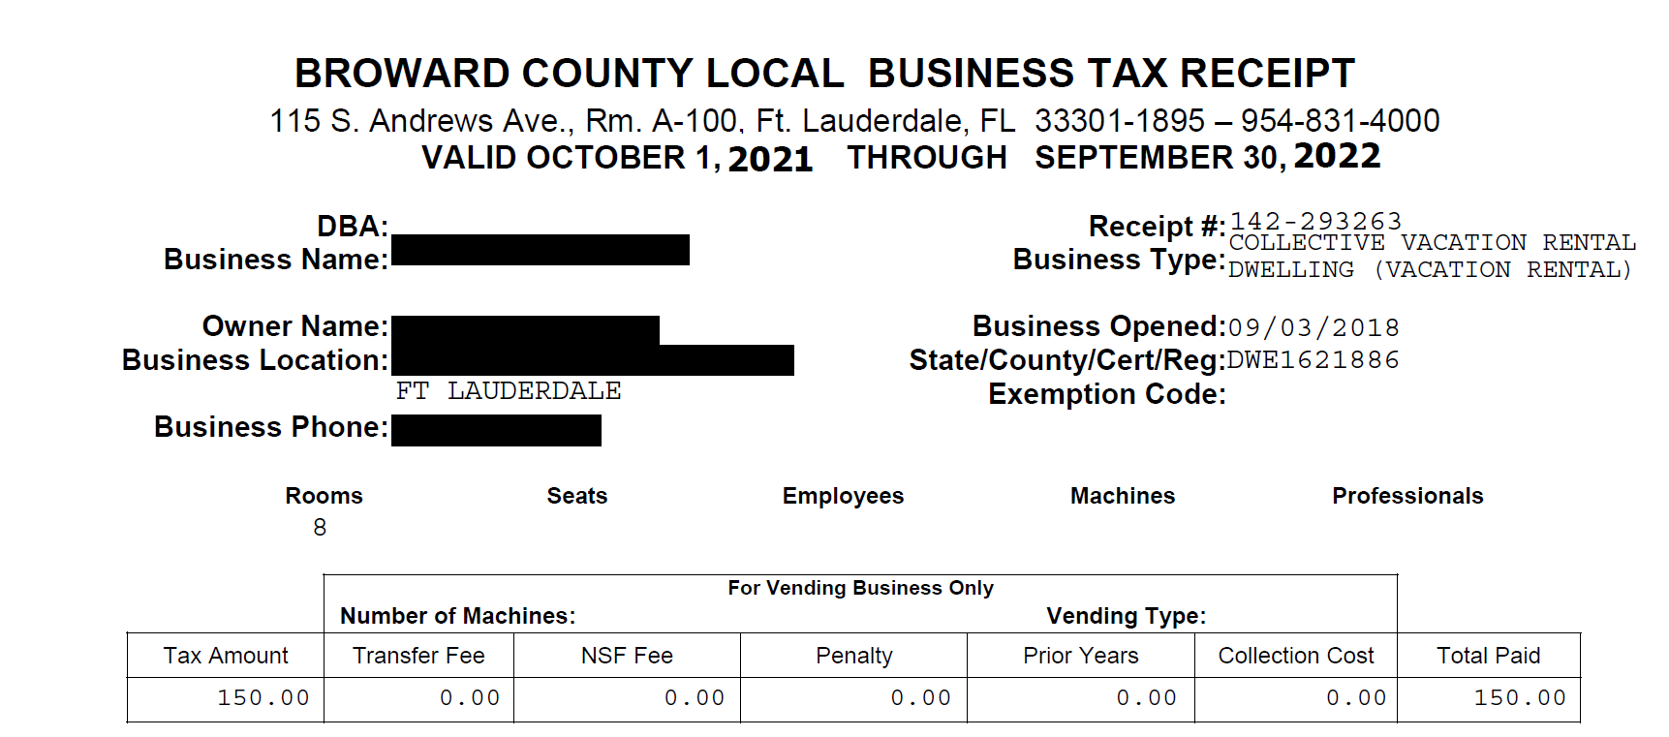
Broward County Business Tax

Slide 17
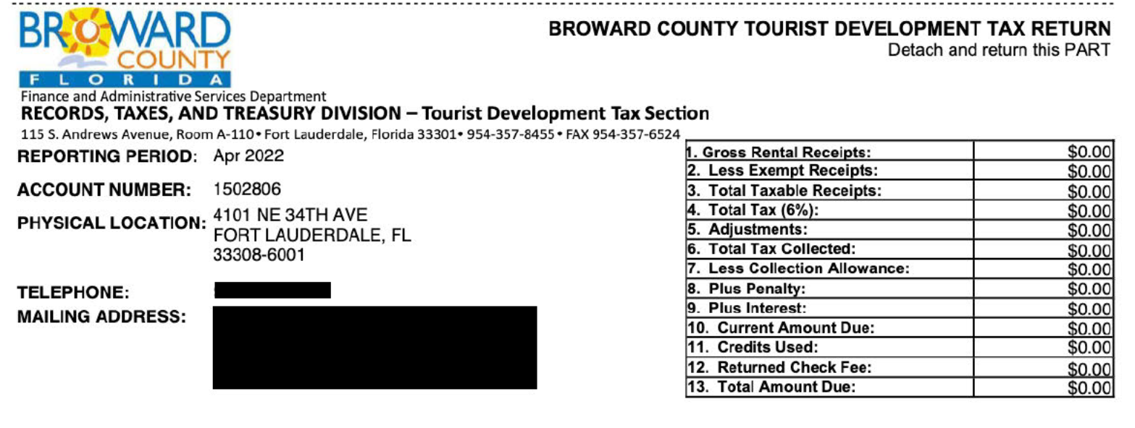
Broward County Tourist Tax
^{CITY OF FORT LAUDERDALE}
Development Services Department
Community Enhancement & Compliance Division

Slide 18
City of Fort Lauderdale Licensing
^{CITY OF FORT LAUDERDALE}
Development Services Department
Community Enhancement & Compliance Division
1. Complete Application via LauderBuild
2. Administrative Review
3. Payment Made
4. Referral for Inspection
Fee Type | Fee Amount
Initial Registration | $350.00
Non-Owner Occupied Renewal | $160.00
Owner Occupied Vacation Rental Renewal Registration | $80.00
Safety Inspection, Re-Inspection and No-Show Inspection | $75.00
Late Registration | $75.00
Transfer Rental Agent | $35.00
Business Tax License Fee (Prorated: October 1st - March 31st) | $157.50
Business Tax License Fee (Prorated: April 1st - June 30th) | $78.75
Business Tax License Fee (Prorated: July 1st - September 30th) | $236.25

Slide 19
Inspections Standards www.fortlauderdale.gov/vacationrental
^{CITY OF FORT LAUDERDALE}
Development Services Department
Community Enhancement & Compliance Division

Slide 20

Exterior Inspection
^{CITY OF FORT LAUDERDALE}
Development Services Department
Community Enhancement & Compliance Division
Landscaping
House Numbers
Outdoor Storage
Paint
Clean Roof
Right-of-Way Obstructions
Trip Hazards
Window Screens

Slide 21
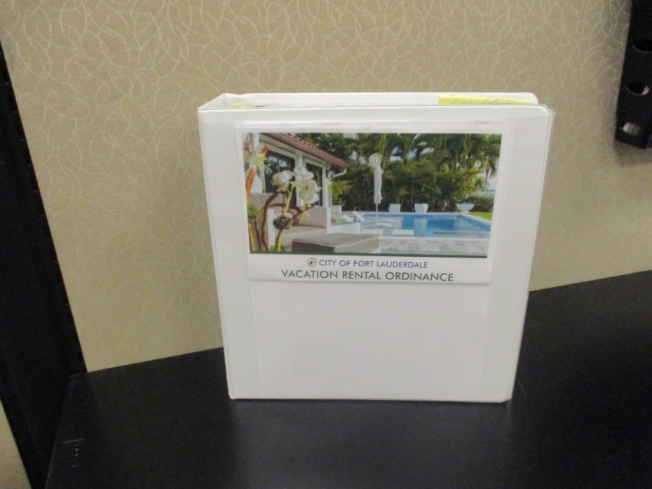
Document Folder
^{CITY OF FORT LAUDERDALE}
Development Services Department
Community Enhancement & Compliance Division
Copy of Vacation Rental Ordinance
Trash and Recycling Times
Location of Nearest Hospital
Non-Emergency Police Number
Sketch of Parking Spaces “No On Street Parking”
Sea Turtle Lighting Notice, if applicable

Slide 22
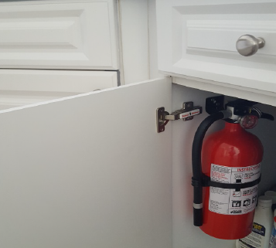
Interior Inspection
^{CITY OF FORT LAUDERDALE}
Development Services Department
Community Enhancement & Compliance Division
Evacuation Map Posted
County and State Licenses Posted
Landline Phone
Fire Extinguisher Class 2-A:10-B:C
Hardwired and Interconnected Smoke Alarms
Carbon Monoxide Detectors (Fossil Fuel Appliances)
Work Without Permits

Slide 23
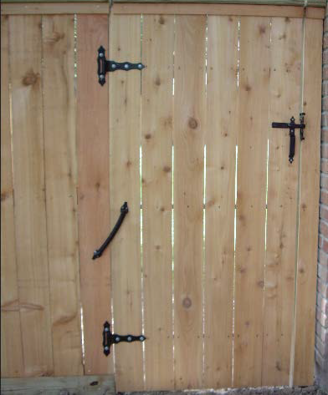
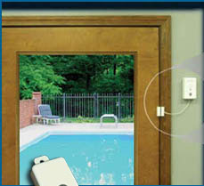
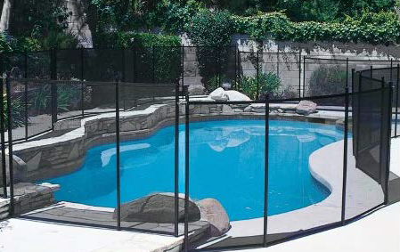
Swimming Pools, Spas, Hot Tubs
^{CITY OF FORT LAUDERDALE}
Development Services Department
Community Enhancement & Compliance Division
Option 1: Alarms required on all windows and doors leading to the pool and a self-latching and self-closing fence is required around the property.
Option 2: Child Barrier Removable Fence (No Alarms or perimeter fence Required).

Slide 24
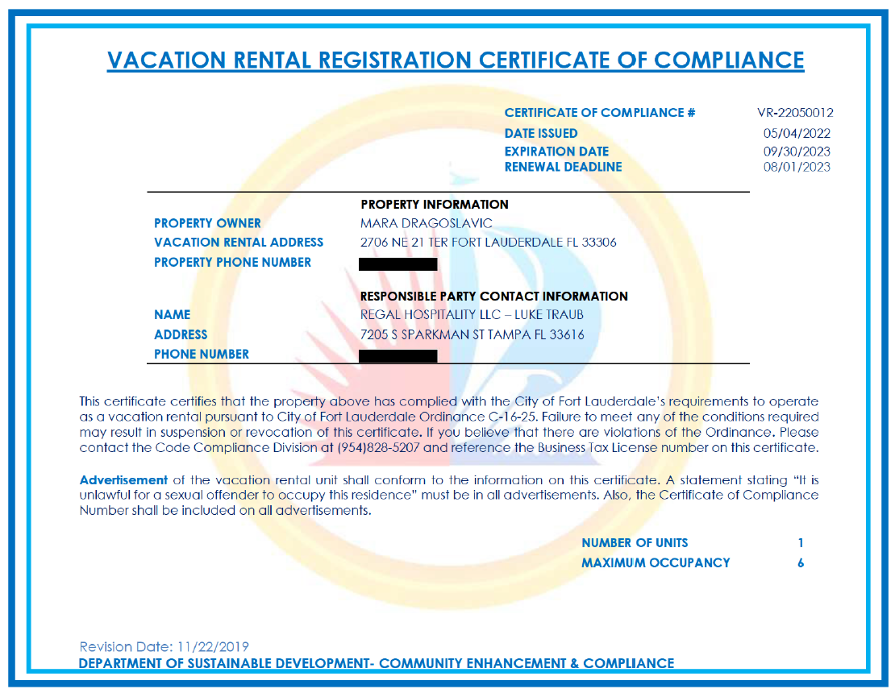

Slide 25
Enforcement vacationrental@fortlauderdale.gov
^{CITY OF FORT LAUDERDALE}
Development Services Department
Community Enhancement & Compliance Division

Slide 26
^{CITY OF FORT LAUDERDALE}
Development Services Department
Community Enhancement & Compliance Division
Enforcement Overview
Common Violations
Operating Without a Certificate
Noise
Parking
Trash Carts
Exceeding Maximum Occupancy
Operating With an Expired Certificate

Slide 27
^{CITY OF FORT LAUDERDALE}
Development Services Department
Community Enhancement & Compliance Division
367 - total unregistered properties
244 - ceased operating
114 - registered with the City
9 out of compliance (6 liened in past 90 days)

Slide 28
^{CITY OF FORT LAUDERDALE}
Development Services Department
Community Enhancement & Compliance Division
FY22 – 1,662 registered vacation rentals
156 – verified violations
.09%

Slide 29
^{CITY OF FORT LAUDERDALE}
Development Services Department
Community Enhancement & Compliance Division
How to File Vacation Rental Complaints
Contact Community Enhancement
  Contacting Responsible Party
24/7 Customer Service Line
Citizen Complaint Portal
Support from hosting platforms (Airbnb, VRBO)

Slide 30
^{CITY OF FORT LAUDERDALE}
Development Services Department
Community Enhancement & Compliance Division
Collaboration with the Police Department
Explain Vacation Rental Regulations
Provide Written Guidelines/Expectations
Request Bodycam Footage
Request Written Statement of Findings
Share Community Feedback

Slide 31

Technology – Monitoring
^{CITY OF FORT LAUDERDALE}
Development Services Department
Community Enhancement & Compliance Division

Slide 32
^{CITY OF FORT LAUDERDALE}
Development Services Department
Community Enhancement & Compliance Division
Monitoring Companies
Scope of Contract
Provide a list of all registered and unregistered short term vacation rentals address within the City of Fort Lauderdale's jurisdiction.
Ongoing monitoring of the short-term rentals.
Weekly reports and dashboards.
Documentation of Information used to establish property is a vacation rental.
Send annual notices.
Accuracy guarantee.
24/7 Customer Service Call Center
Harmari (LTAS Technologies)
Host Compliance (Granicus)
STR Helper
STR Monitor
Lodging Revs

Slide 33
^{CITY OF FORT LAUDERDALE}
Development Services Department
Community Enhancement & Compliance Division
SUGGESTED BEST PRACTICES
Define the Problem
  Understand the State’s pre-emption
  Registration
  Enforcement
  Staff Resources
  Create an Online Community for Resources
  Registration
  Enforcement
  Filing a Complaint
  Procedures
  Know Your Resources
  Technology
  Police
  Industry
  Practical Enforcement
  Evolve Based on Community Feedback
  Prioritize Enforcement (i.e. registered rentals or unregistered rentals)
  Use Civil Citations or Other Standard Enforcement Form
  Implement Best Practices
  Create a plan for your after-hours response

Slide 34
Questions?
^{CITY OF FORT LAUDERDALE}
Development Services Department
Community Enhancement & Compliance Division

